Slide 1




Project Title:-Crop Prediction
Using Machine Learning
Team ID:-IM_9488
Team Leader Name:-Bhavana Sriram
Team Member 1:-Shiva Sriram
Team Member 2:-Sandhya Jangili
Team Member 3:-Rani Palle

Slide 2

Project Objectives
Problem Statement
Project Overview – Introduction
End Users
Wow Factor in Project
Modelling/Block Diagram/Flow of Project
Result/outcomes
Conclusion
Future Perspective

Slide 3
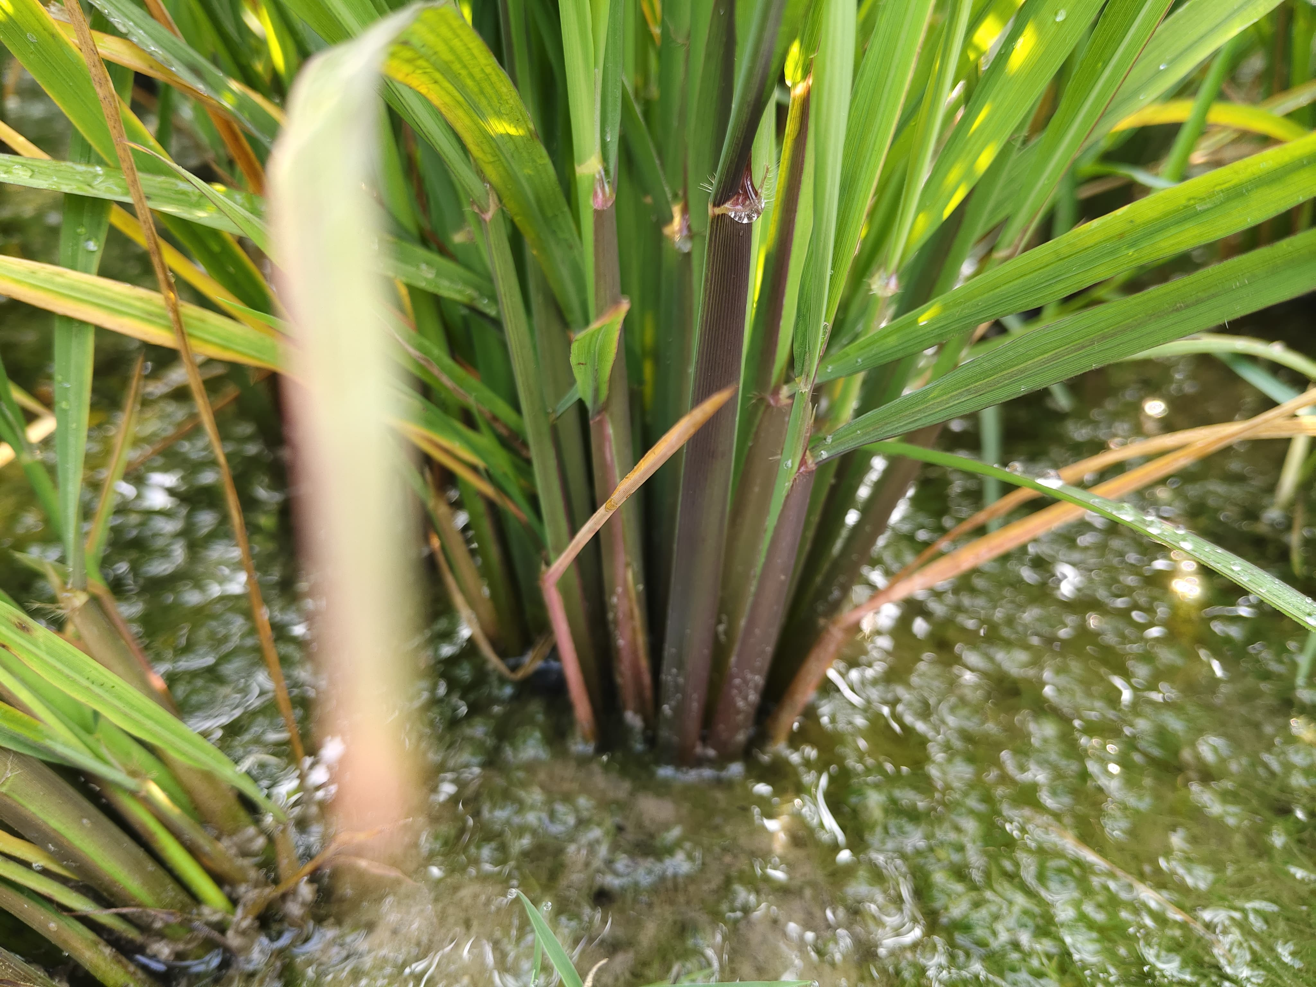
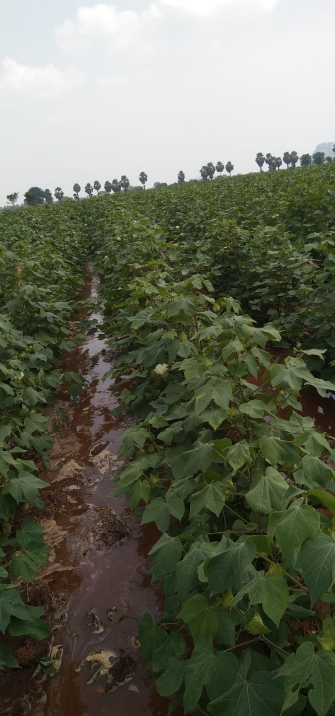
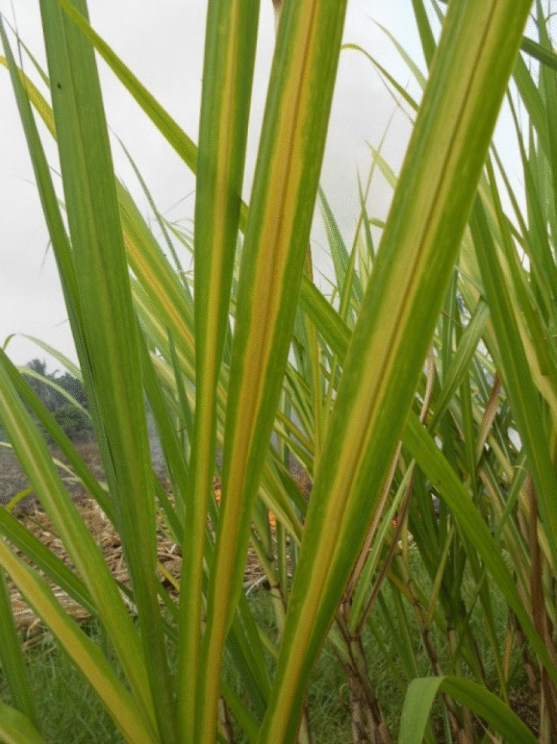
Problem Statement
The Crop Prediction using machine learning project aims to Accurate crop prediction for sustainability situations like
1) Yield estimation under climate variability,
2) Soil fertility impact on crops,
3) Rainfall dependency for paddy growth,
4) Pest influence on yield prediction,
5) Market demand-based crop selection.
current crop prediction methods face challenges due to climate change, unpredictable weather patterns and soil degradation, highlighting the need for advanced machine learning solutions.

Slide 4
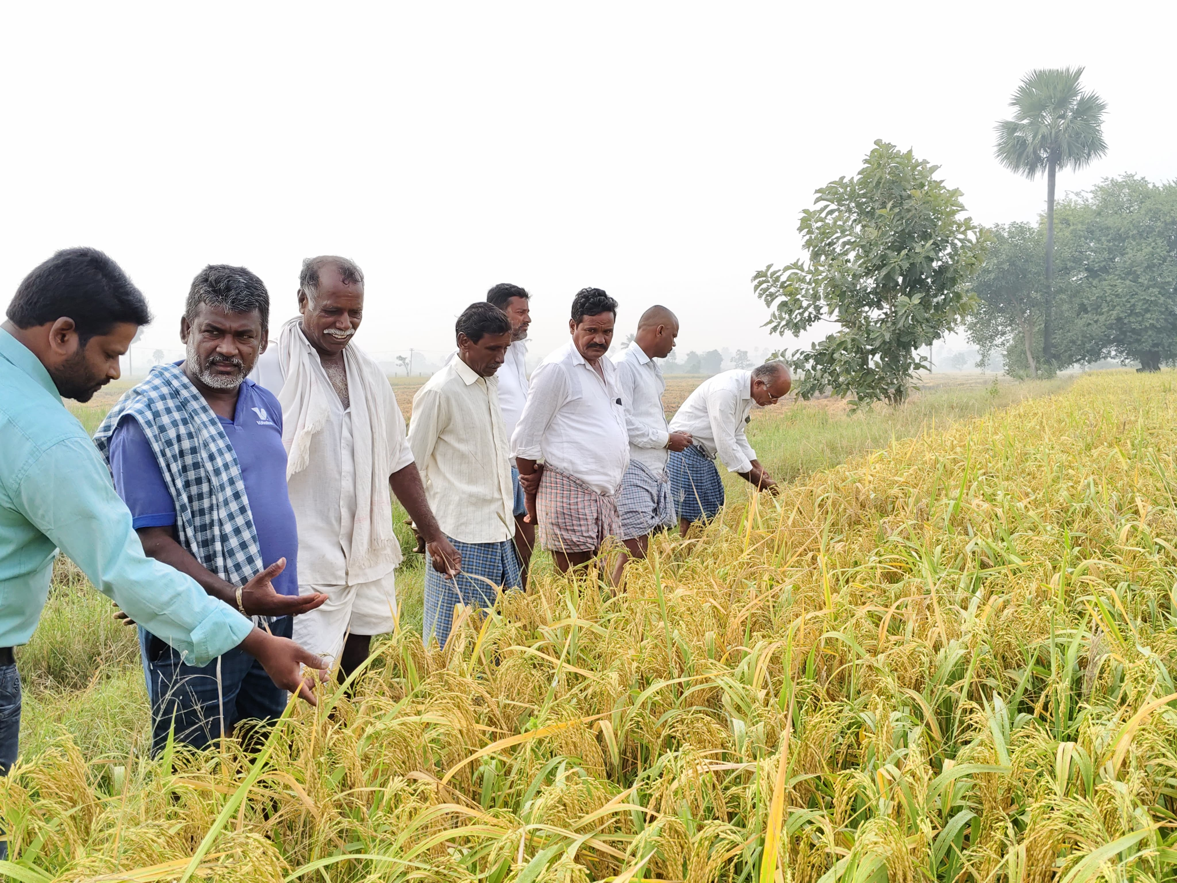
Project overview - Introduction
The Crop Prediction using Machine Learning project is designed to improve agricultural productivity and sustainability. By analyzing key factors such as weather conditions, soil health, rainfall, and historical yield data, the model provides accurate forecasts. Machine learning algorithms process vast datasets to identify patterns and correlations, enabling farmers to make informed decisions about crop selection, planting schedules, and resource allocation. This technology helps mitigate the risks associated with climate change, unpredictable weather, and pest infestation. By integrating AI-driven solutions into agriculture, the project promotes sustainable framing practices, reduces economic loses, and improves overall efficiency, ensuring a stable and reliable food supply for future generations.

Slide 5
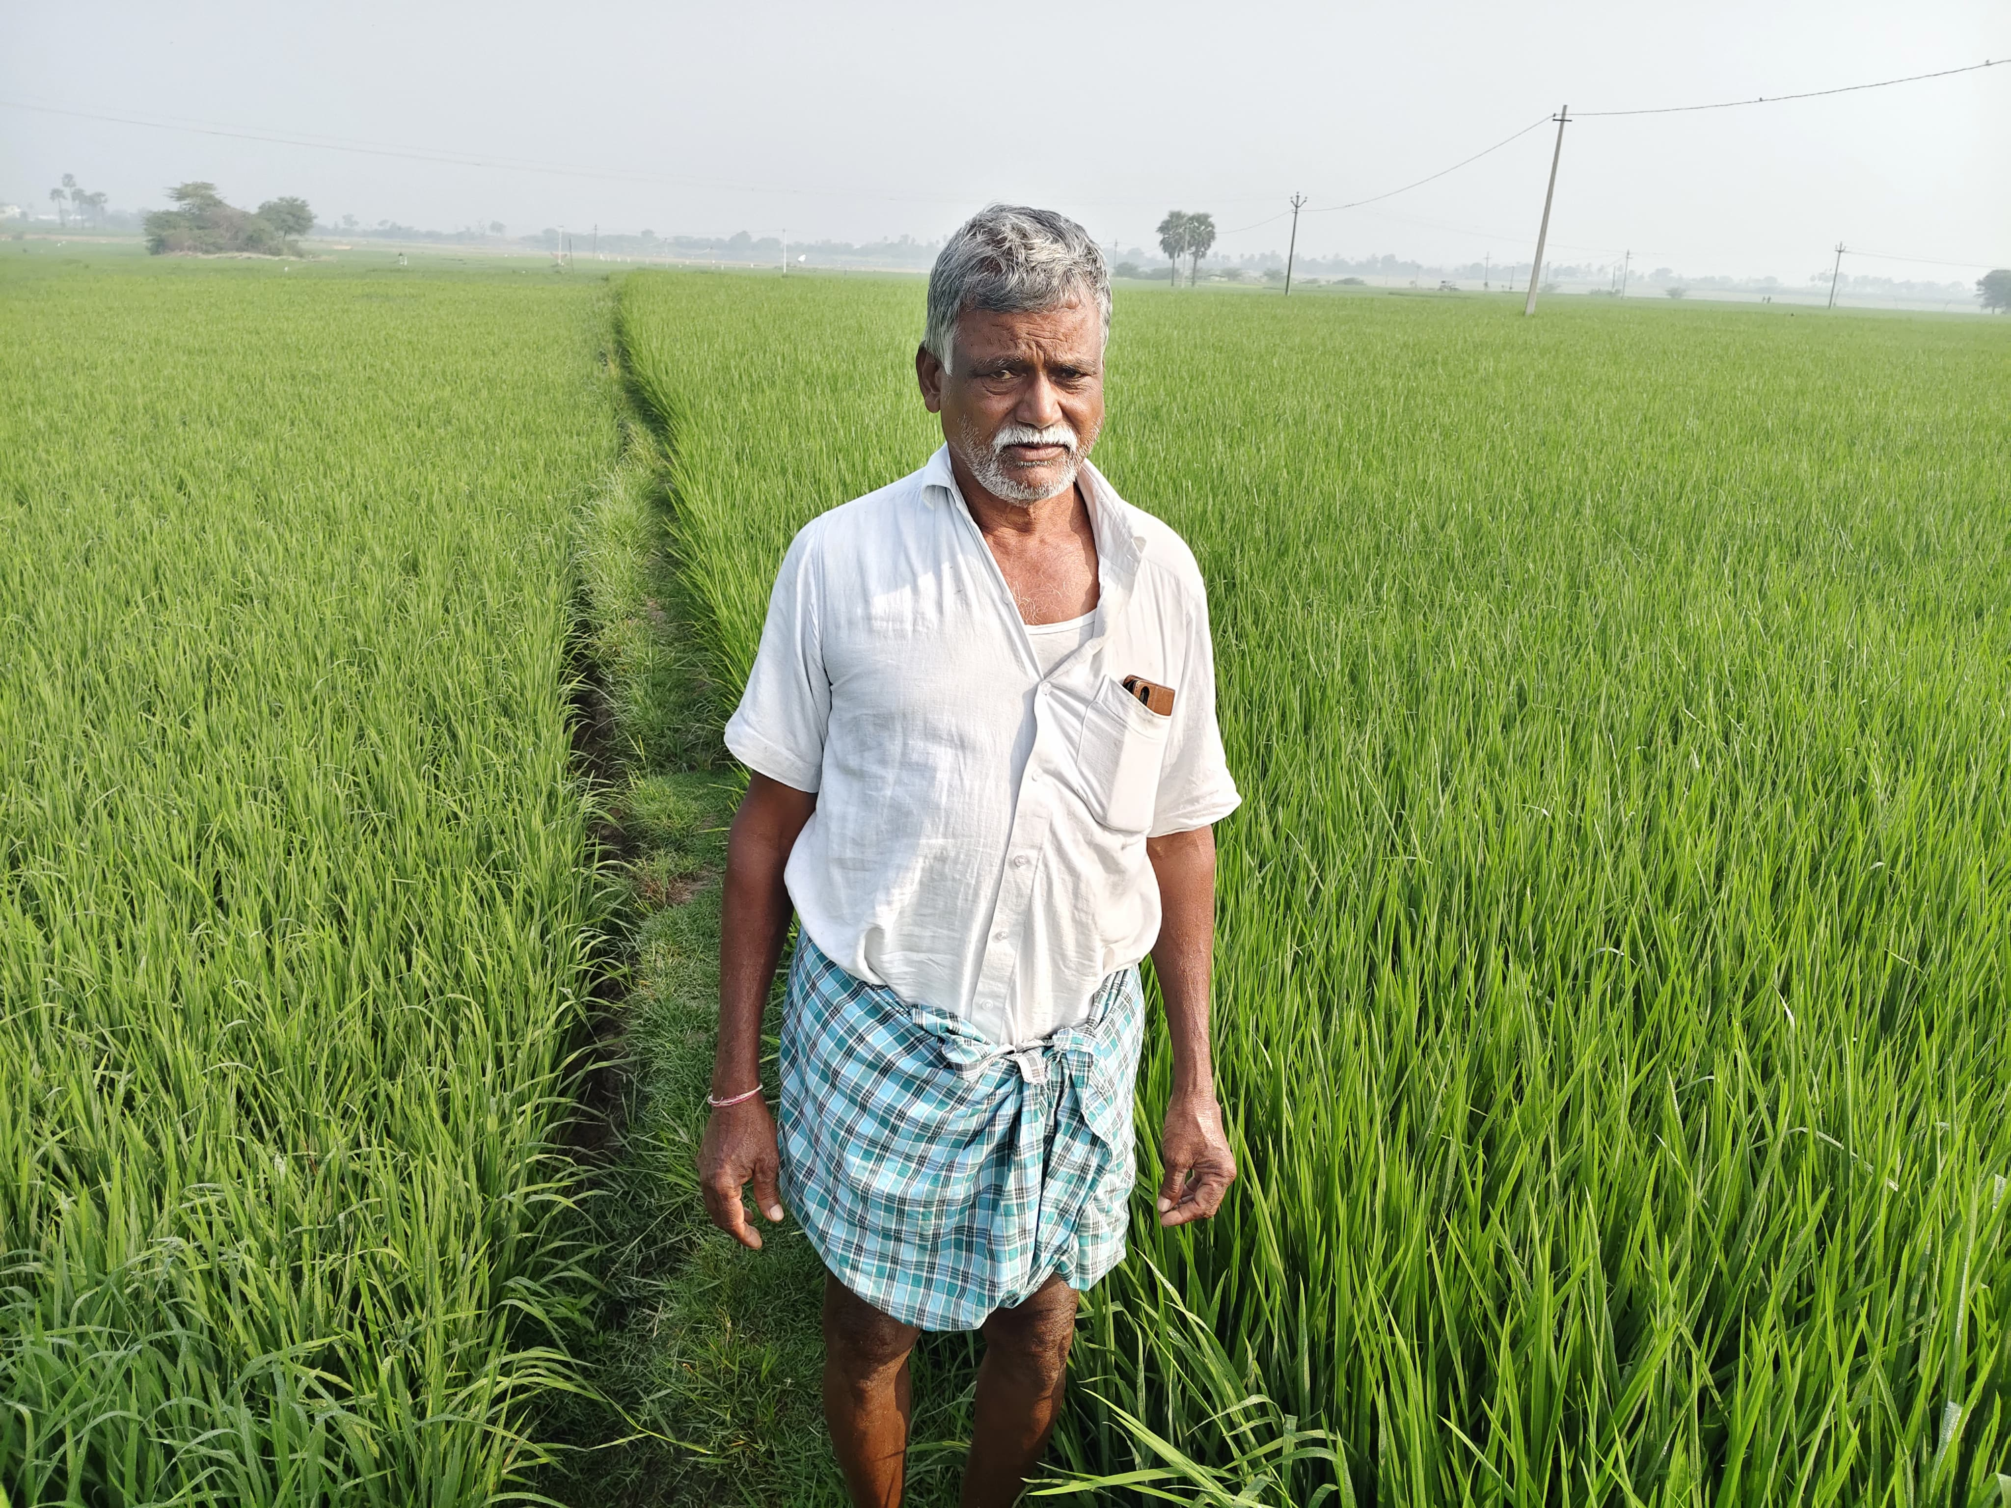
End User
Farmers

Slide 6
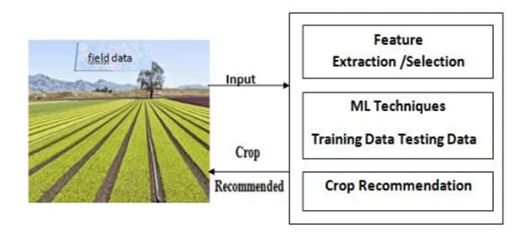
Wow Factor in Solution
Effective Recommendation: Suggest best crop based on yield prediction and market demand for better productivity.
Real-time Tracking: Monitors crop growth and helps farmers make quick and informed decisions.
Improve Safety: Protecting user data through authentication, encryption, and access control measures.

Slide 7
Modelling
Data Collection & Processing: Gather historical data on soil type, weather, rainfall, and past yields, then clean and normalize it for accuracy.
Feature Selection & Engineering: Identify key factors affecting crop growth, such as temperature, soil nutrients, and humidity, to improve model performance.
Model Selection & Testing: Choosing appropriate machine learning algorithms based on data complexity and accuracy requirement like Regression model, Classification model, Deep learning to train the model on historical data.
Testing & Evaluation: Validate the model using testing datasets and performance metrics like accuracy, RMSE, and F1-score to ensure reliability
Deployment & Real-time Prediction: Deploy the model on cloud or mobile platforms to a user-friendly application for farmers continuous prediction updates.

Slide 8
FLOW CHART
Crop production data
Pesticides data
Climate data
Testing and Evaluation
phase
preprocessing
Testing models
Data Analysis
Picking best models
Based on
Performance metrices
Feature Engineering
Training Phase
Encoding categorical variables
Random Forest
GBM
Decision System
New Crop Yield
Data
Normalization
SVM
Log transforming targets
Estimating Crop
yield
Randomly picking 70% of the data as training set and 30% as testing set

Slide 9

Result / Outcomes
We developed a user-friendly platform with a Login and Registration page where farmers can create accounts and securely access the system.
The Crop yield Prediction page allows farmers to enter details like soil type, temperature, and rainfall to get accurate yield forecasts.
This helps them make informed decisions, improve productivity, and make profits efficiently.

Slide 10

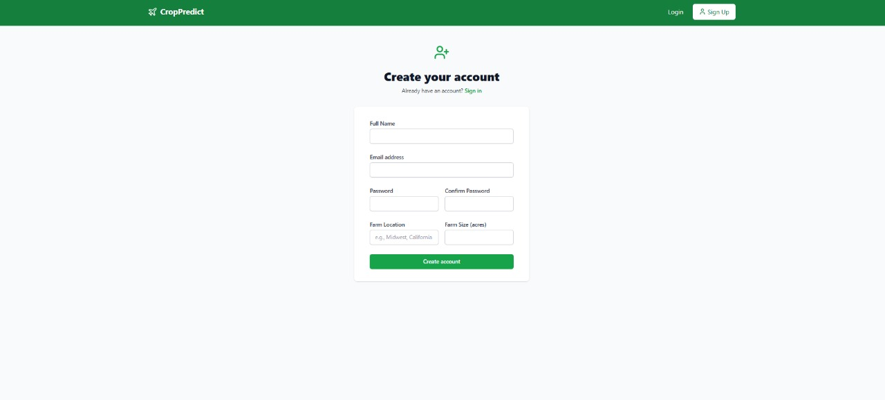
Fig.1: Home & Login Page
Fg.2: Farmer Registration Page

Slide 11
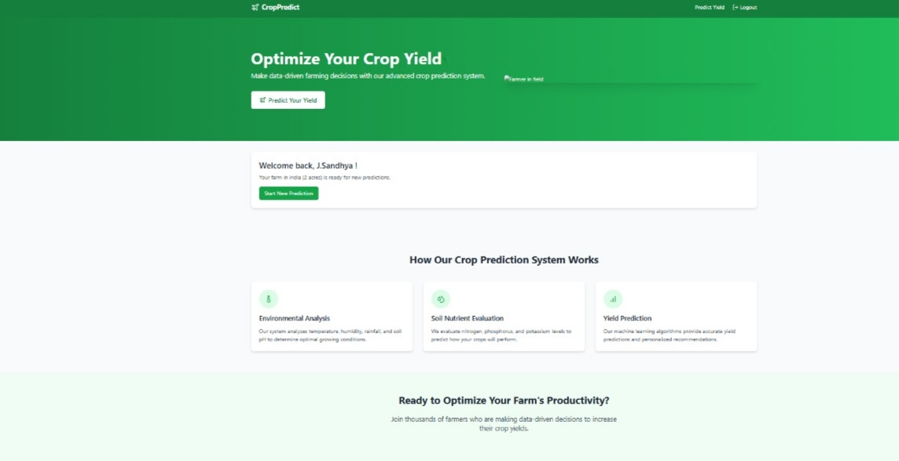
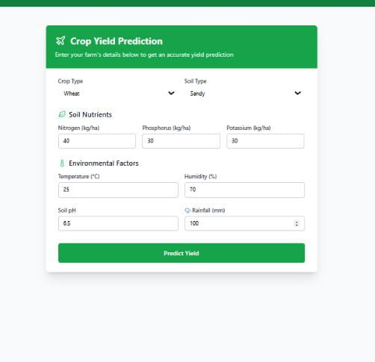
Fig.3: Crop Yield Prediction Page
Fig.4: Crop Yield Prediction Result

Slide 12
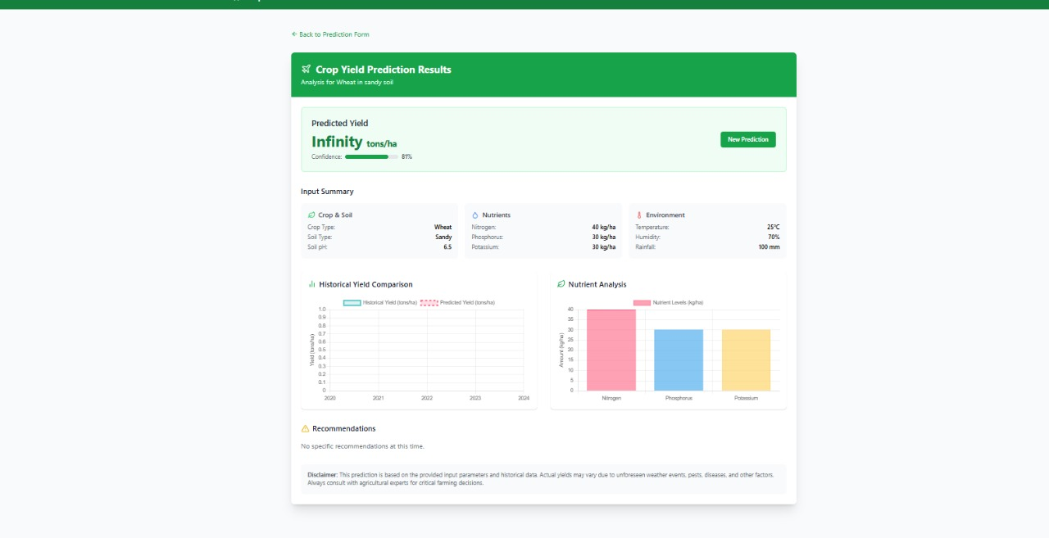
Fig.6: Crop Prediction Result

Slide 13
CONCLUSION
Our Team successfully implemented a Machine Learning model to help framers to predict the best crop to grow based on past data and weather conditions.
By using advance technology like Deep Learning, Regression model, Classification model, we can solve the problems of the crops.
With our solution farmers can save time, increase productivity, and better to predict their crops.
Implementing of our project will helpful in future by estimating crop production, optimize resources,
reduces losses, improve planning, and ensure food security efficiency.

Slide 14
Future Perspective
The Crop Prediction using Machine Learning project has exciting growth opportunities for the future. Here’s how the project can evolve:
Expansion:
Future advancements in machine learning will enhance crop prediction accuracy, optimize yield forecasting, detect diseases early, and enable data-driven precision farming..
New Services:
AI-Powered Crop Advisory: Personalized recommendations for farmers based on real-time data and historical trends.
Automated Disease Detection: ML-based image analysis for early identification of crop diseases and pest infestations.
Precision Irrigation Management: Smart irrigation systems using ML to optimize water usage based on soil moisture and weather conditions.
Yield Forecasting as a Service: Cloud-based platforms providing predictive analytics for agricultural stakeholders.

Slide 15

Notes:
15

